Slide 1
HOME AUTOMATION SYSTEM
~ASSISTED WITH A MOBILE APP~

Slide 2
Team: BEYOND electricity
Grigoraș Alexandru
Pomîrleanu Roxana
Suflet Ioan

Slide 3
Structure
OBJECTIVES
DESCRIPTION OF THE METODOLOGY
HARDWARE
SOFTWARE
NETWORK
SECURITY
COMPONENTS
EXPERIMENTAL RESULTS
PROJECT FEASIBILITY
REFERENCES

Slide 4
Objectives
The project HOME AUTOMATION SYSTEM demonstrates a system that can be integrated into a building’s electrical system that allows the user to control it with a wireless device such as a Bluetooth enabled mobile phone.

Slide 5
Description of the metodology
1. The user is home
The automatic aspect which allows to control the lighting, electric door, the electric blinds system and the air conditioning.
2. The user is outside the living area
The security system: a series of proximity sensors assures there is no unwanted action in the house. In case it is activated a series of LEDs and spekers indicates the danger and exposes the intruder.

Slide 6
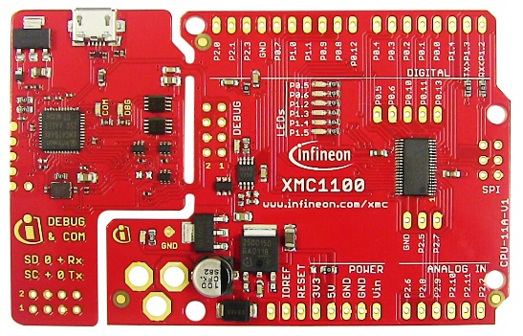
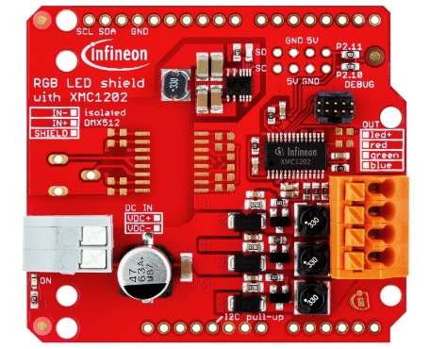
Hardware
XMC1100-T038F0064 AA (32-bit Microcontrollers with ARM® Cortex®-M0)
XMC1202-T016X0016 AA (32-bit Microcontrollers with ARM® Cortex®-M0 with smart application oriented features)

Slide 7
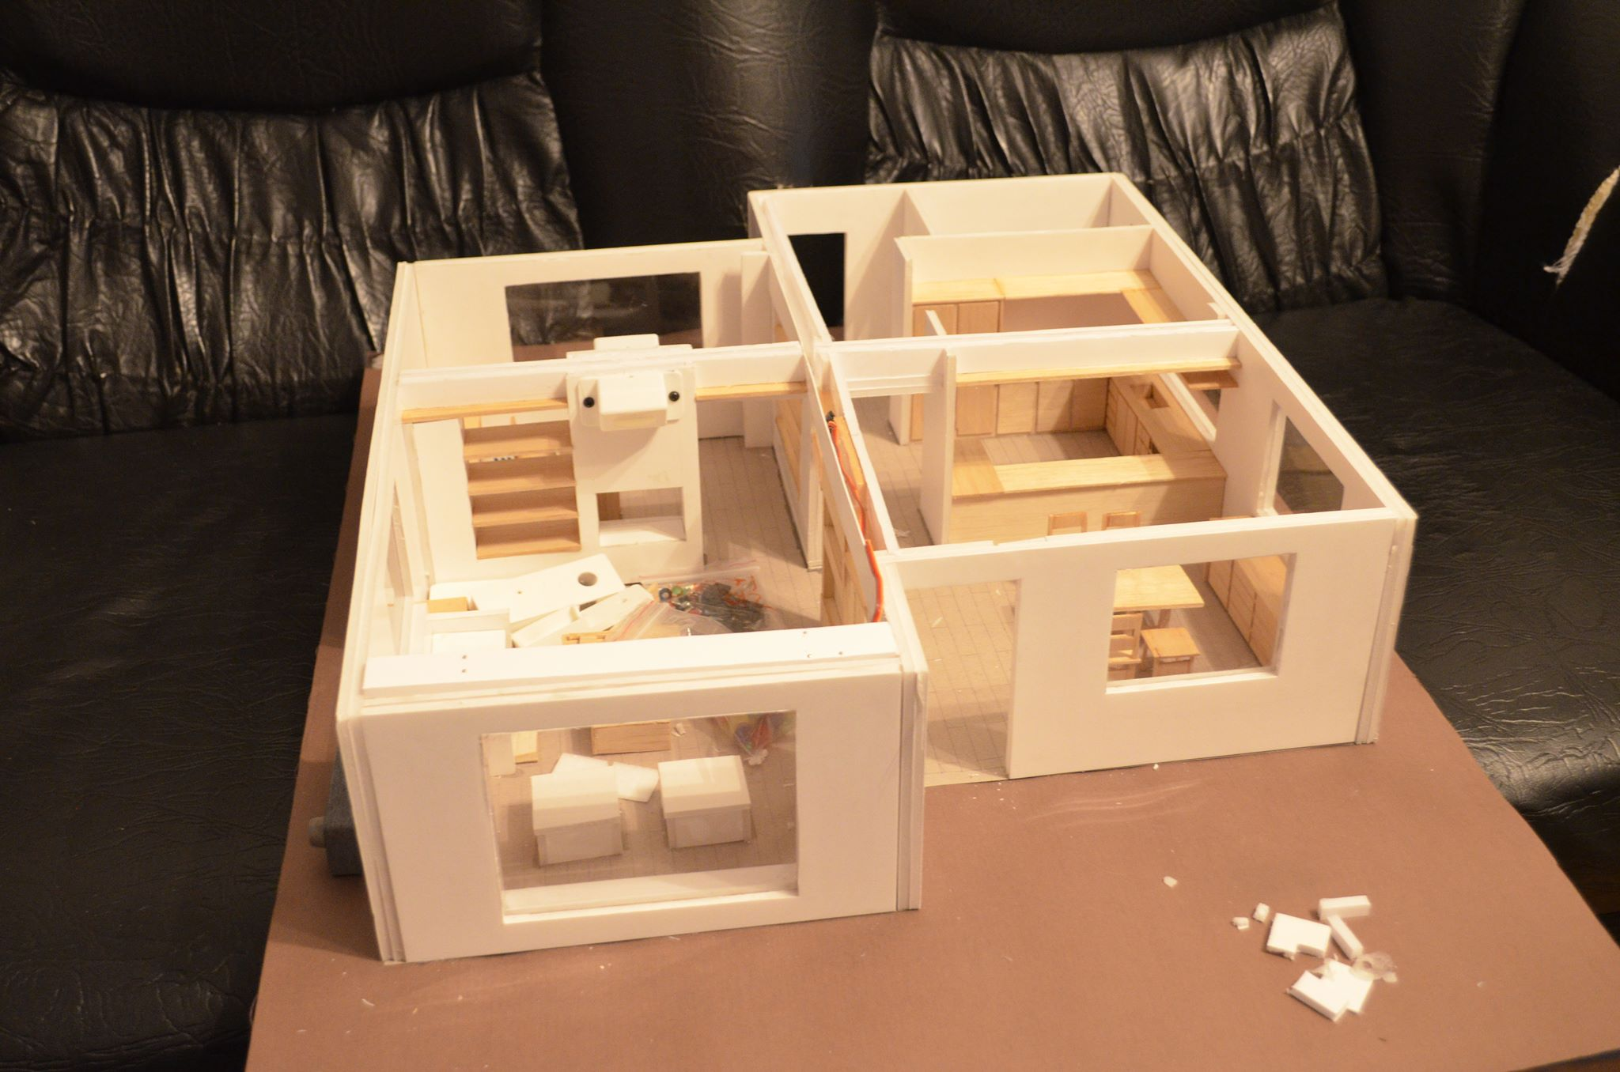
Building the house model

Slide 8
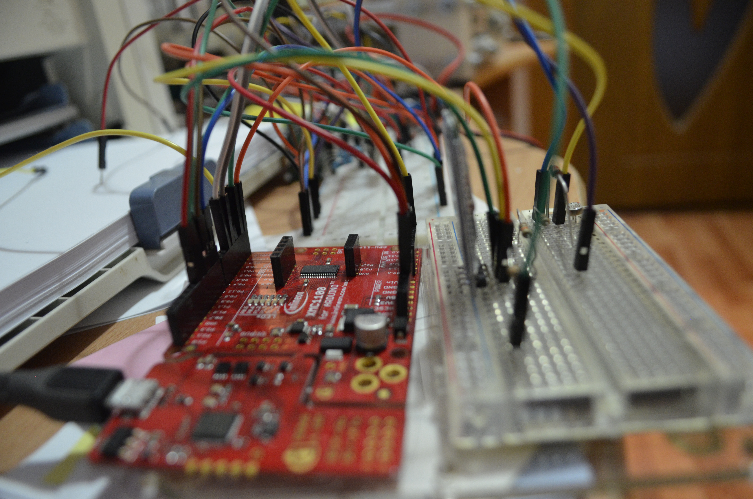
Testing sensors

Slide 9
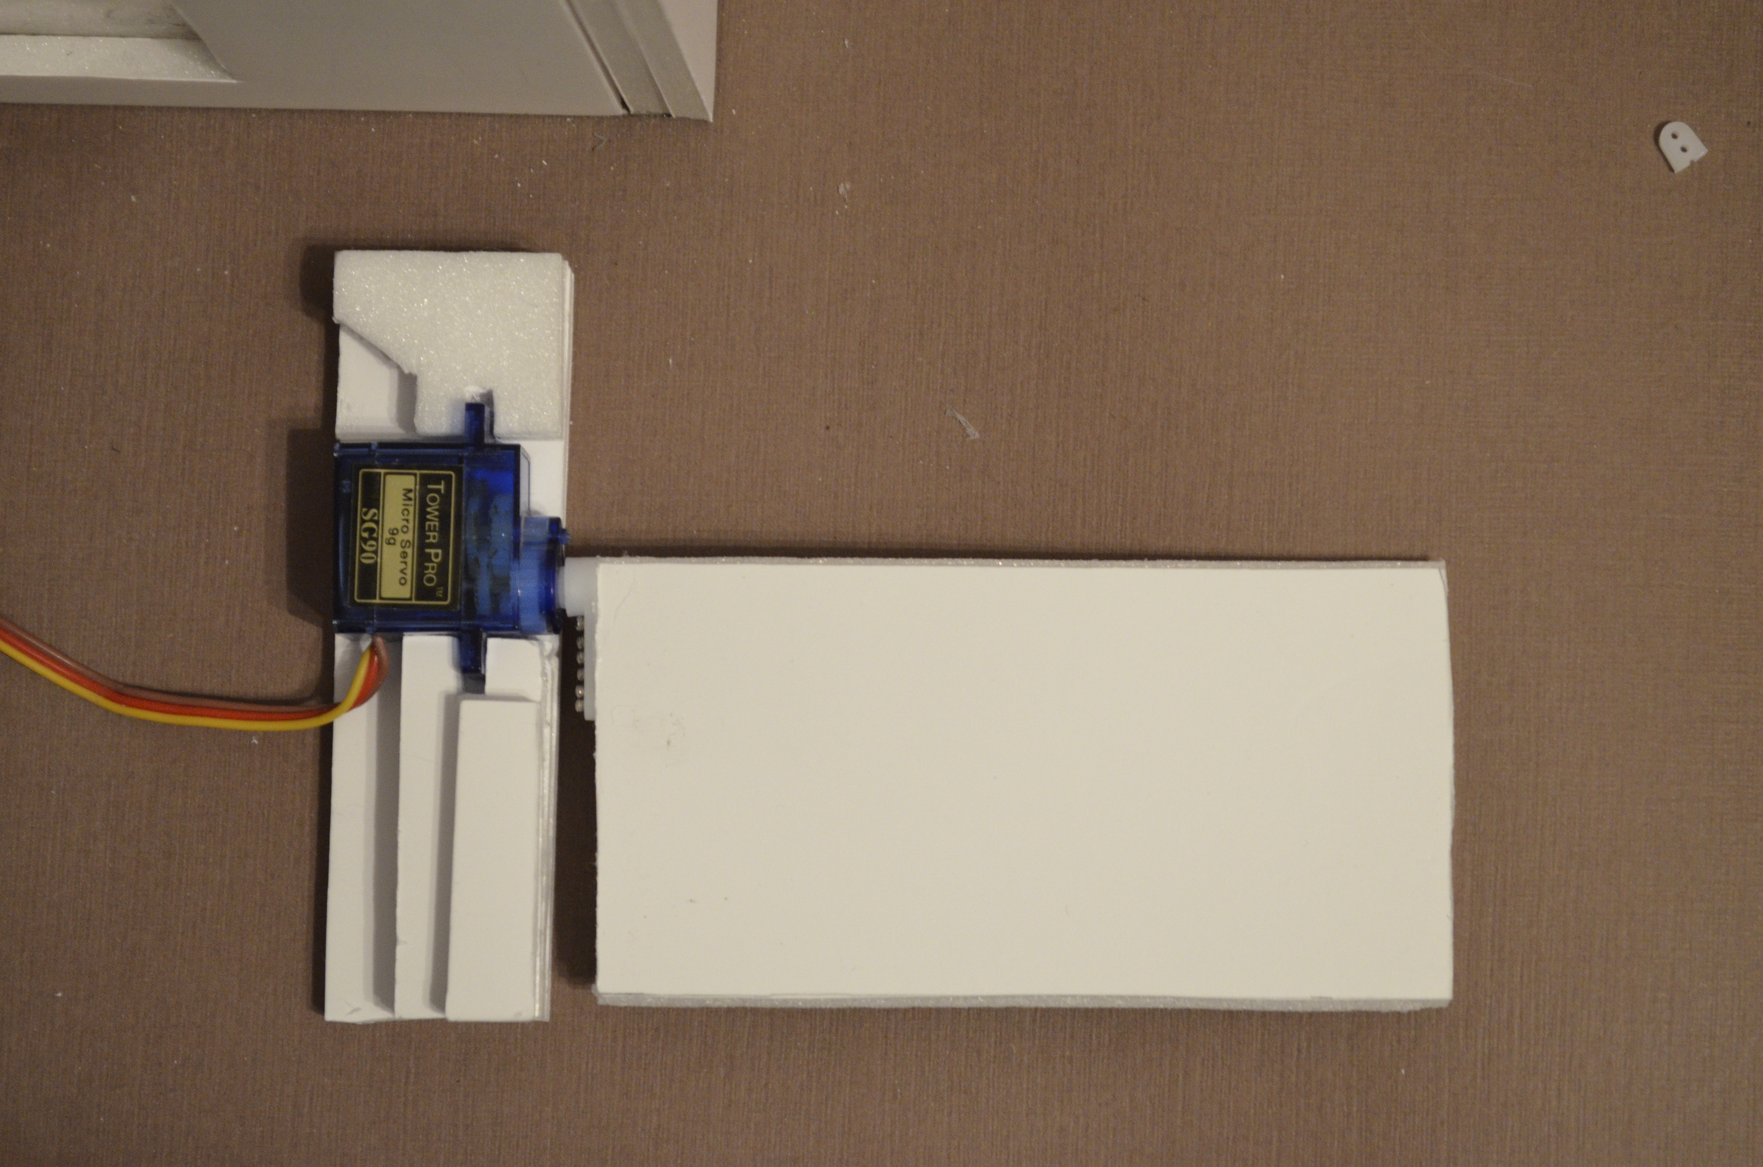
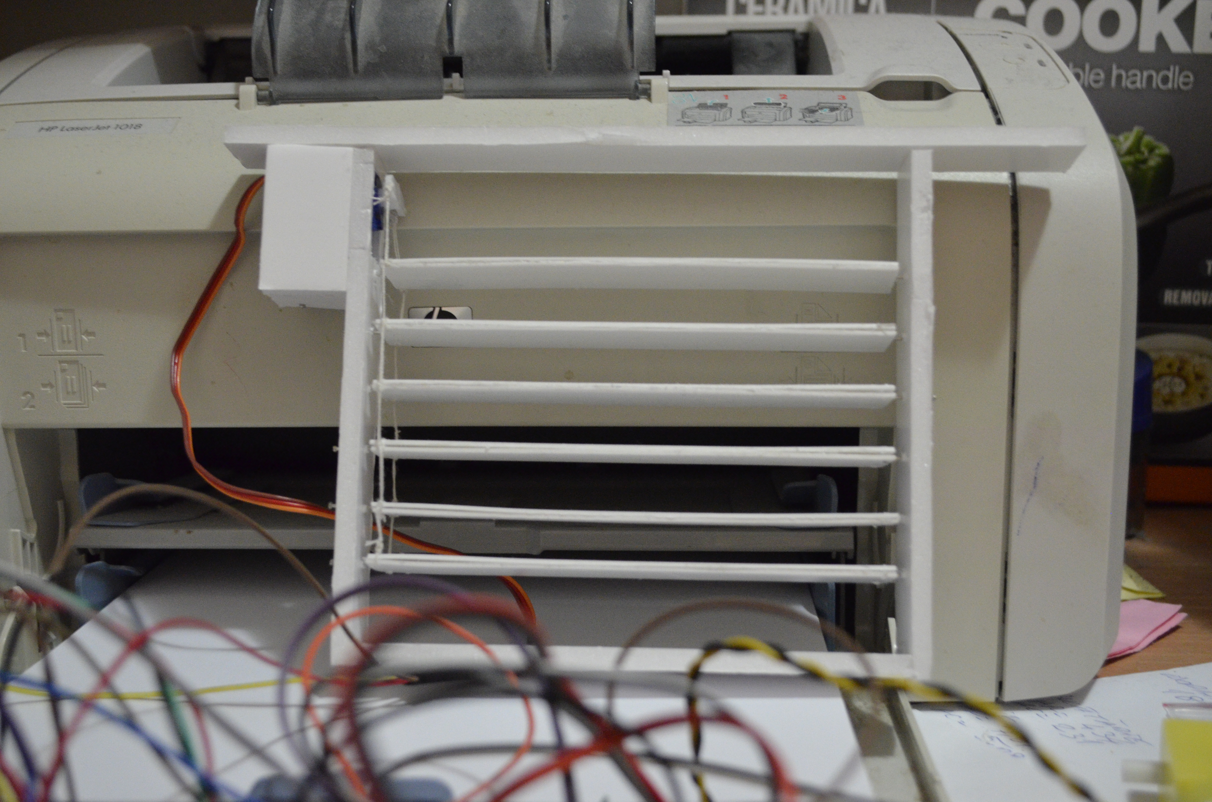
Testing Mechanisms

Slide 10
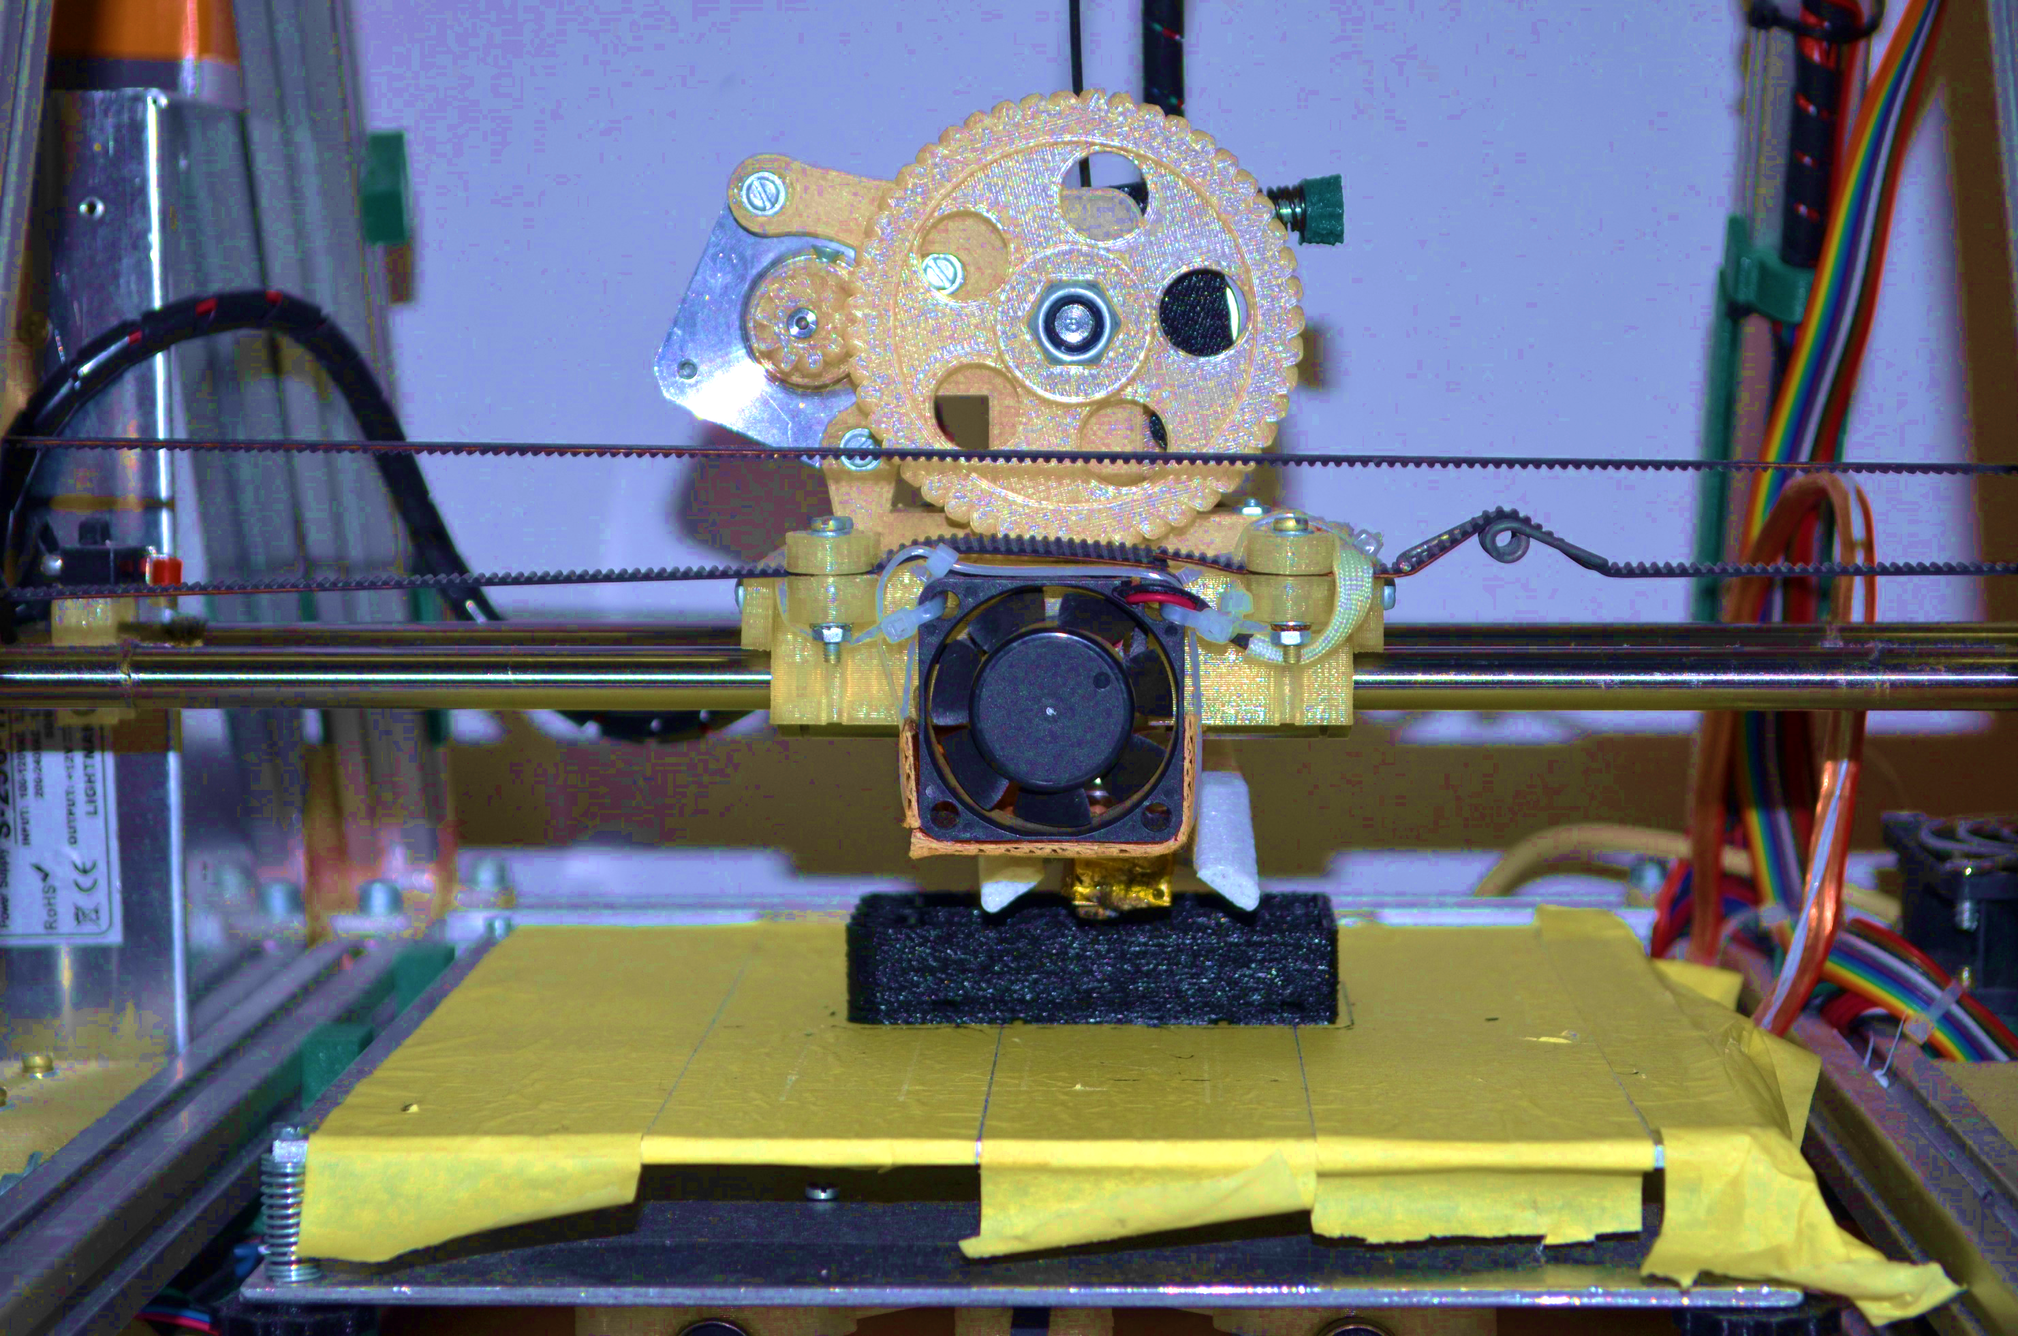
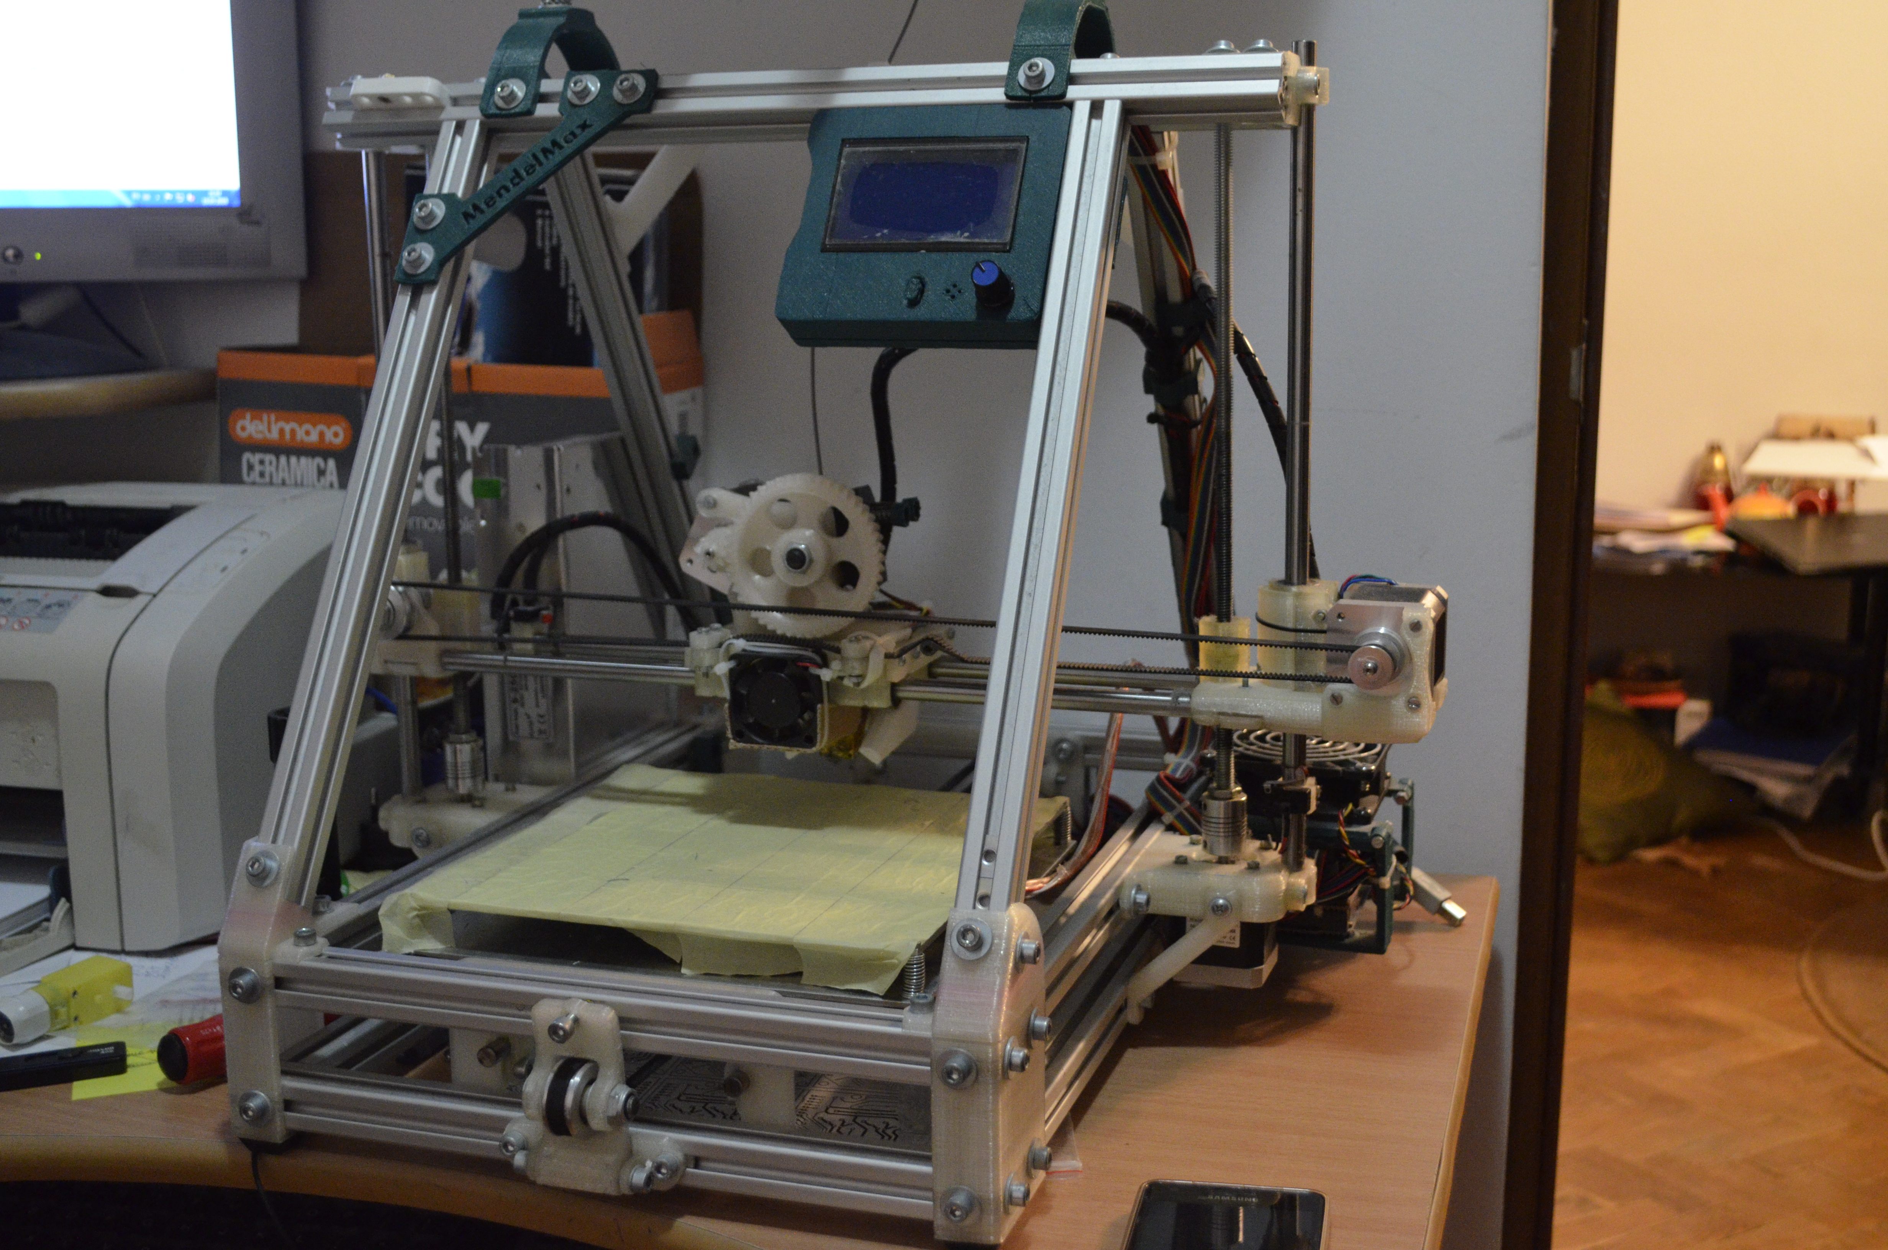
Additional 3D printings

Slide 11
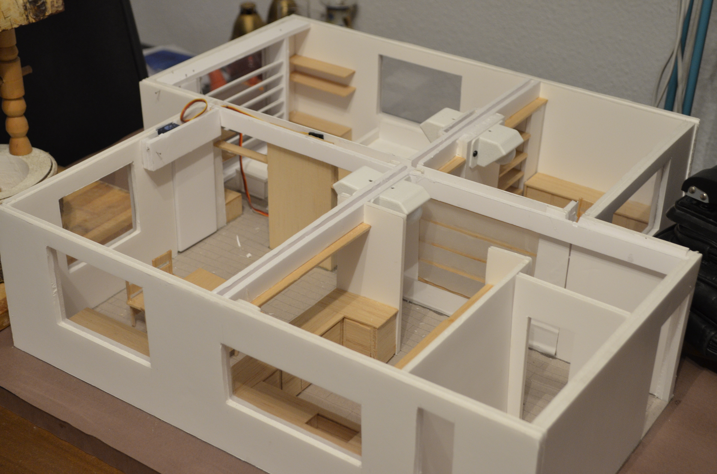
Adding components

Slide 12
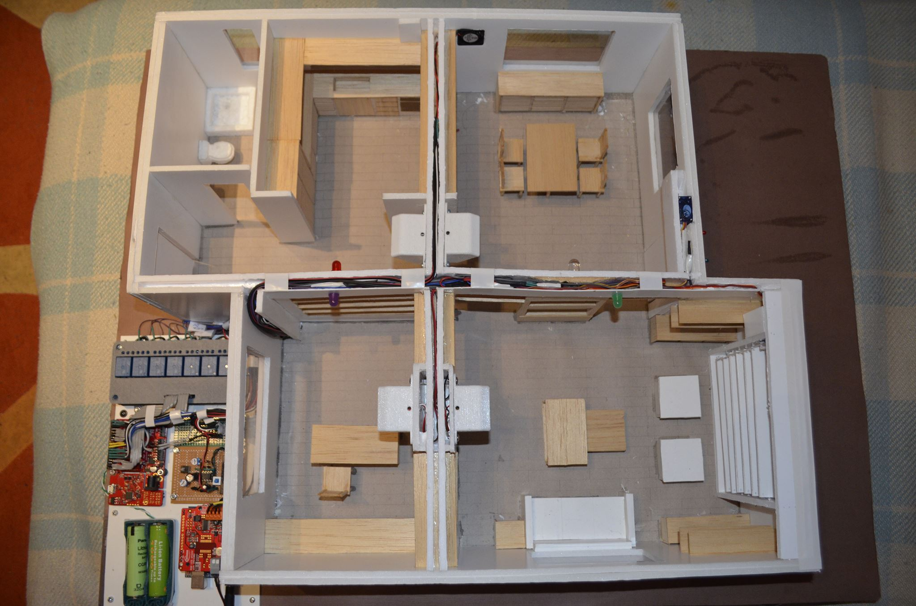
Wire connections

Slide 13
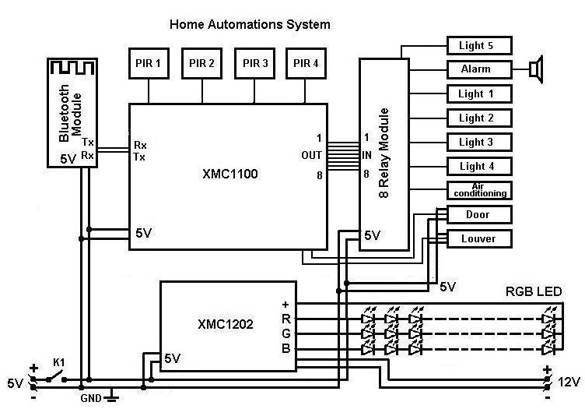
Block diagram

Slide 14
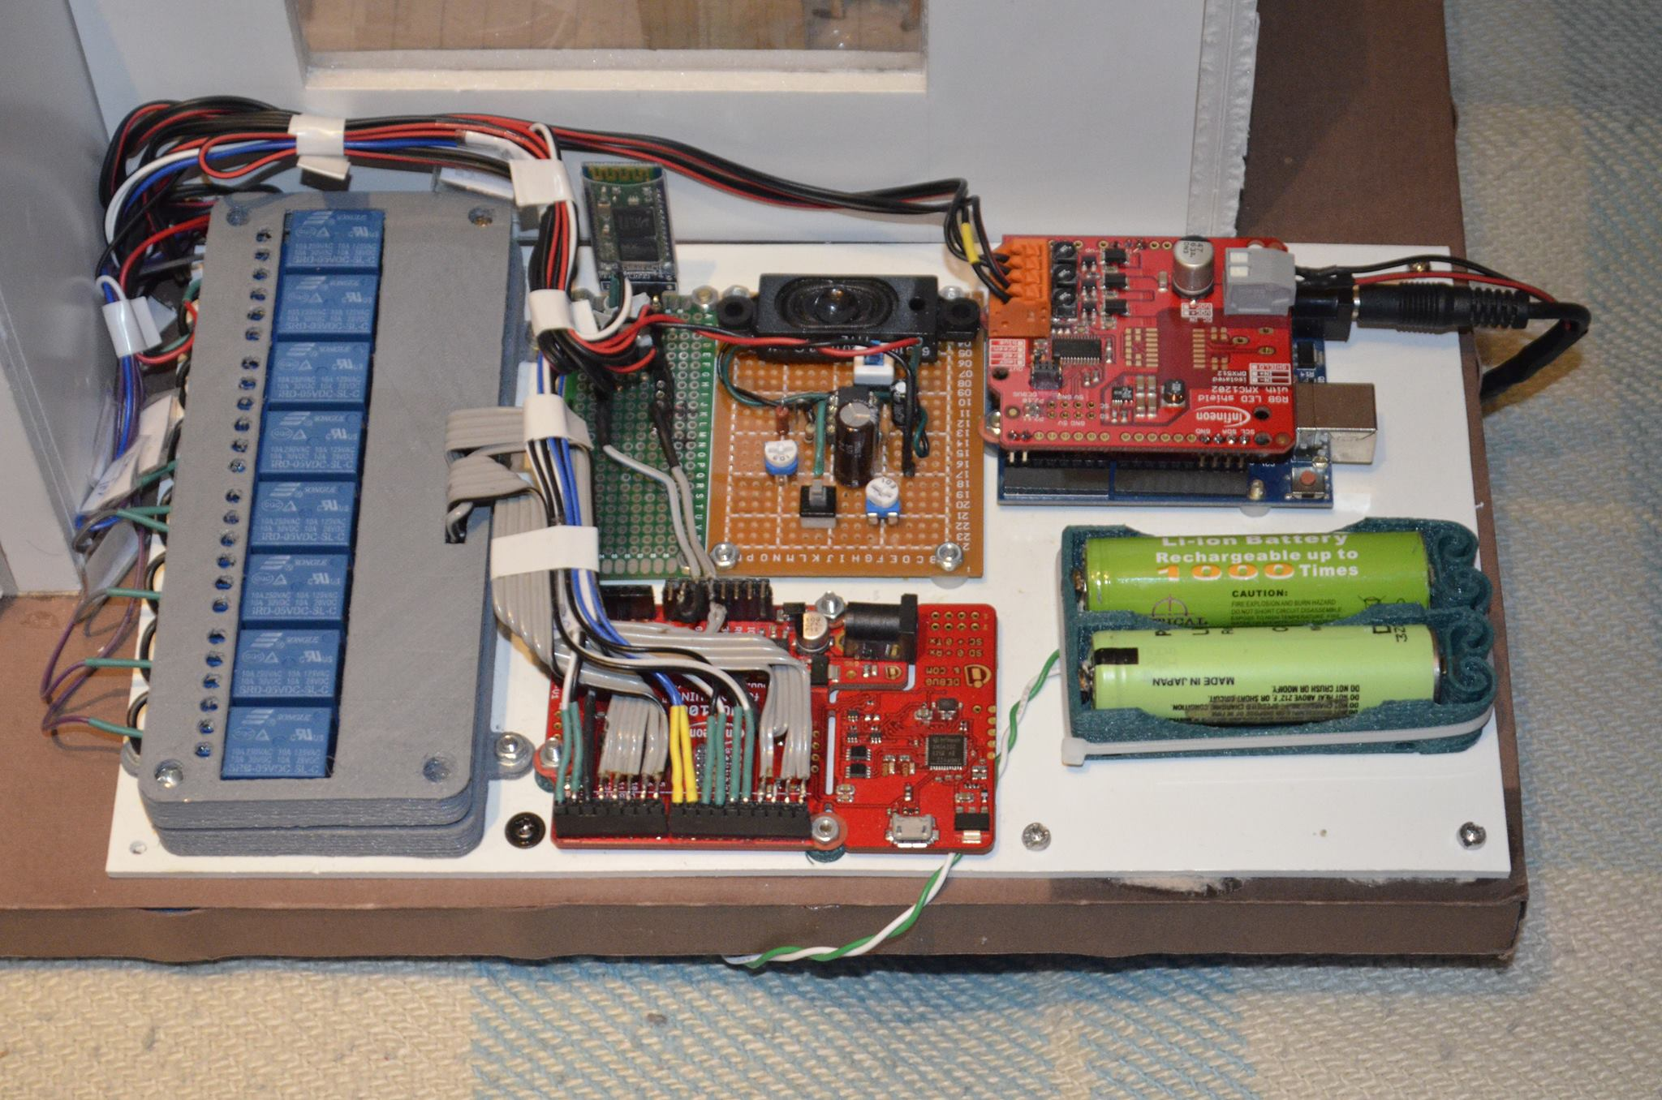
Joining Components

Slide 15
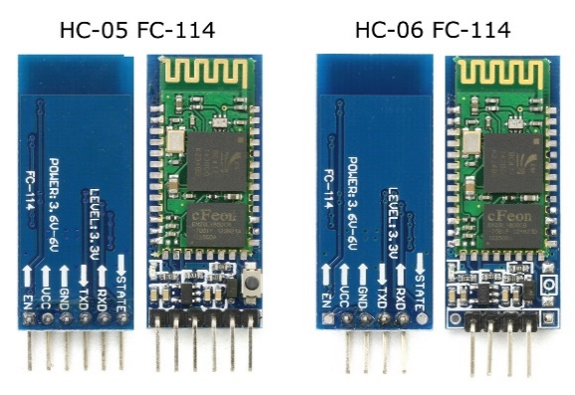
Bluetooth connection
The Bluetooth module the HC-06 is based on, the EGBT-046S, a 3.3V device.

Slide 16
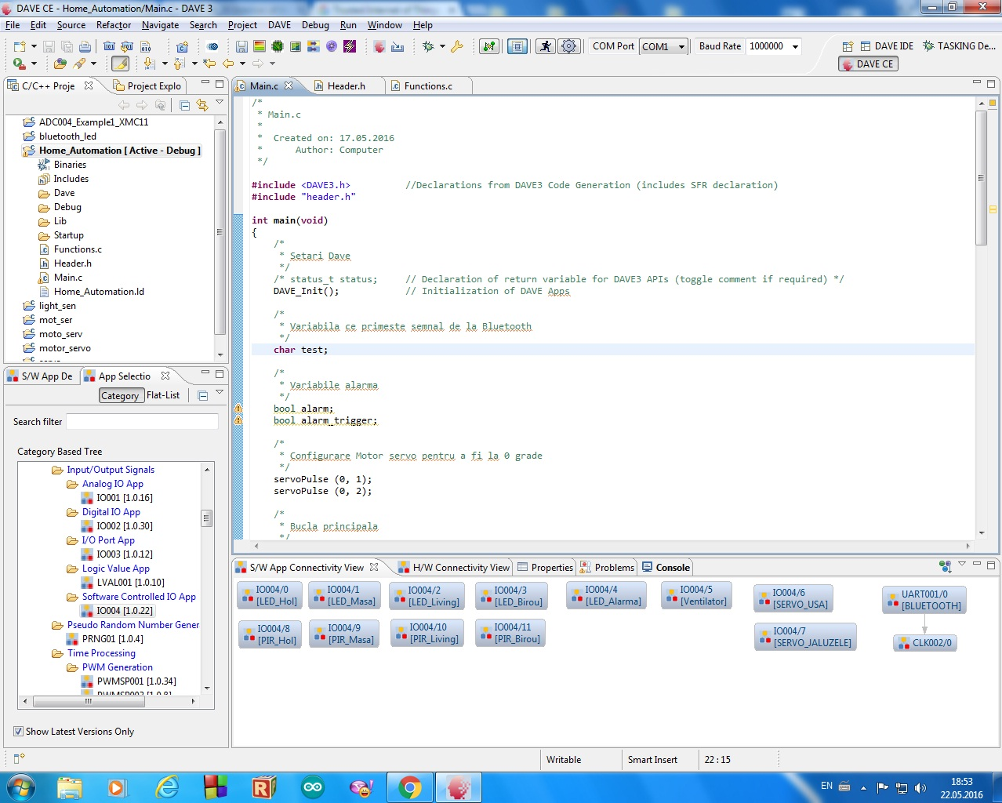
Algorithm

Slide 17
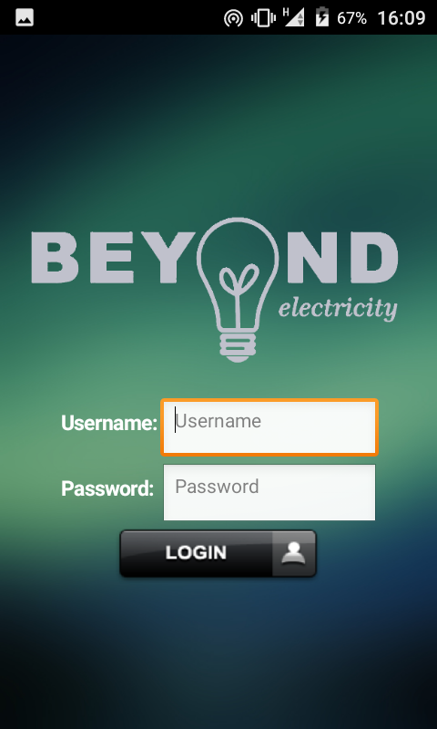
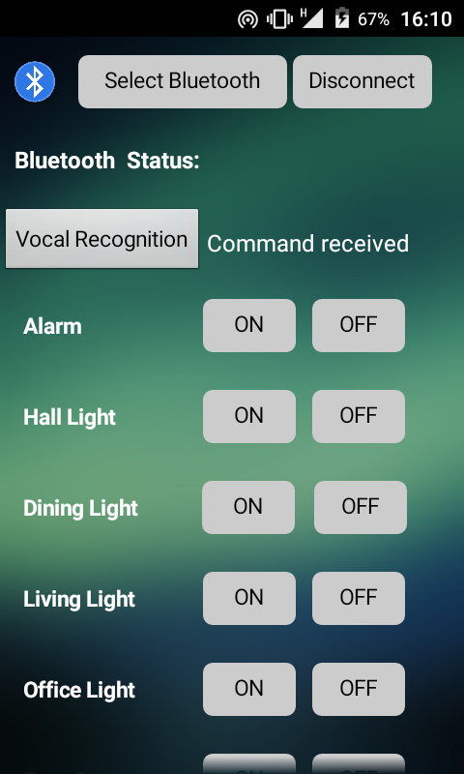
App for Smartphone
Made with MIT App Inventor 2

Slide 18
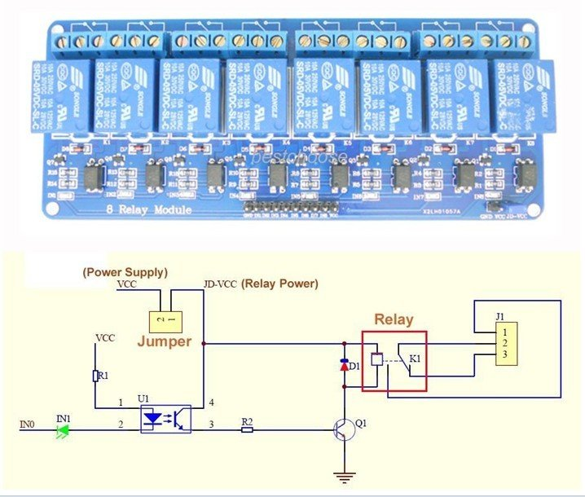
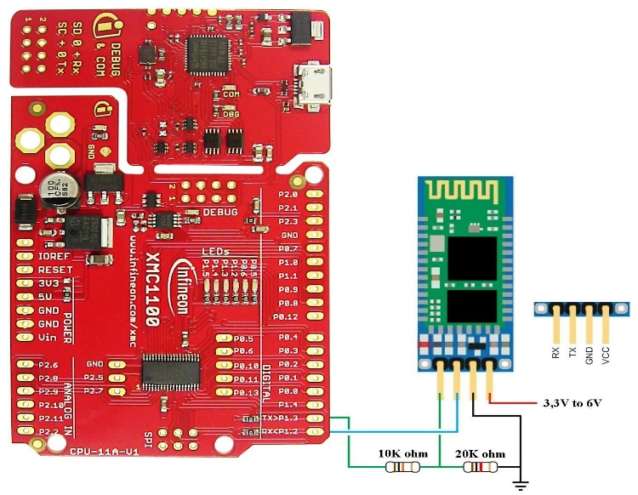
Components
8 Channel DC 5V Relay Module
Bluetooth Module

Slide 19
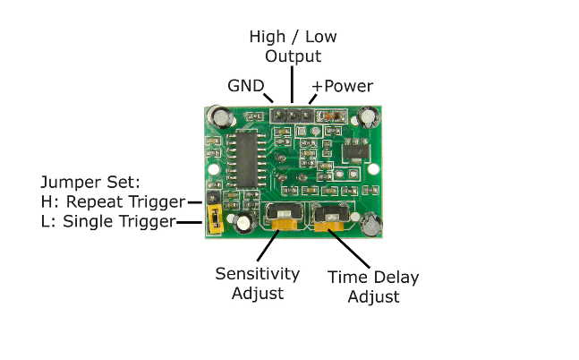
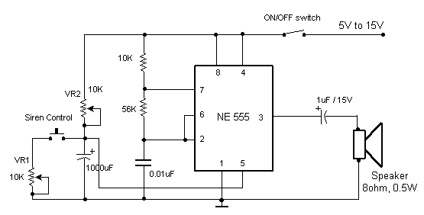
Components
PIR sensor SR501+
Alarm

Slide 20
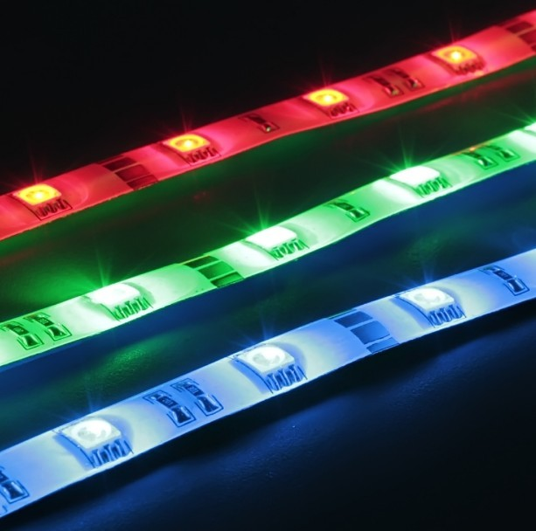
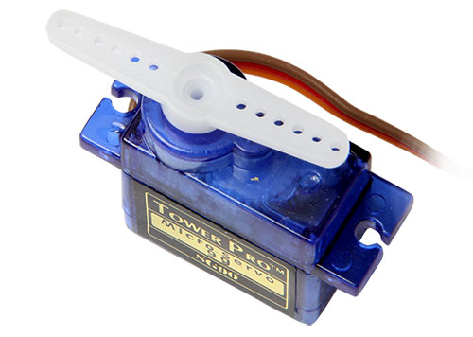
Components
Servo Motor
RGB LED strip

Slide 21
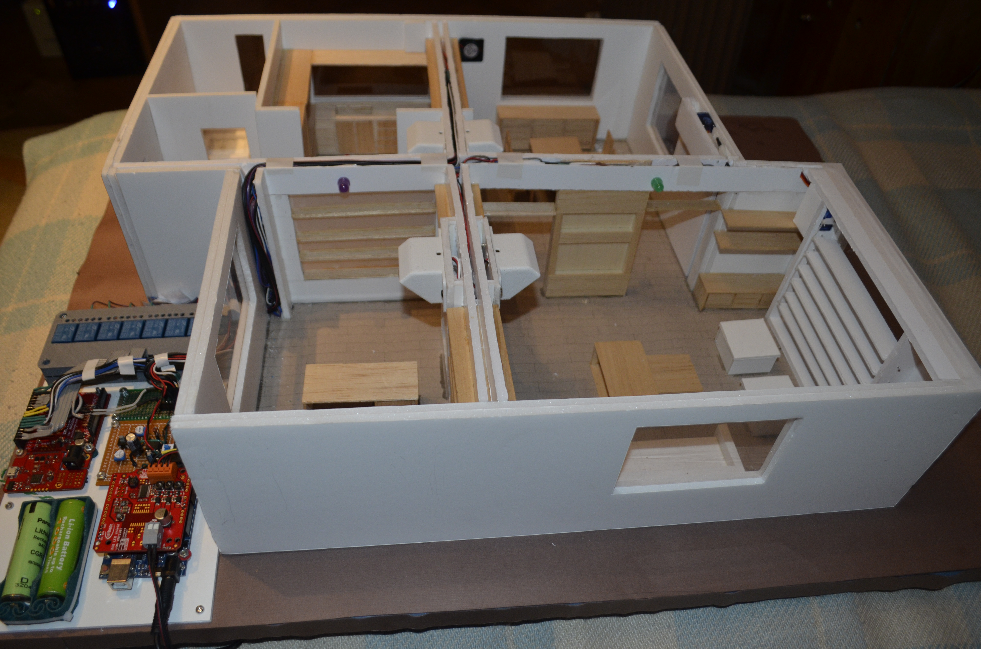
Final results

Slide 22
Project feasibility
The project is 100% applicable for real houses but at a differend scale. It can also be easily adapted for customer preferences.

Slide 23


Slide 24
References
http://www.infineon.com
http://www.embedac.ro/Infineon/index.htmls
http://usgroup.eu/activities/infineon/
https://www.olimex.com/Products/Components/RF/BLUETOOTH-SERIAL-HC-06/resources/hc06.pdf
https://cdn-learn.adafruit.com/downloads/pdf/pir-passive-infrared-proximity-motion-sensor.pdf
http://electronics.stackexchange.com/questions/208625/jumper-setting-modes-in-pir-motion-sensor

Slide 25
BIG THANKS !

